Slide 1

Capstone Project – Segmentation and Predictive. Modeling
BIA 690 Capstone
Professor Nabeel
Tristin Burdick
December, 14, 2023

Slide 2
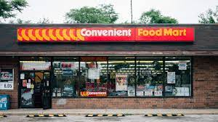
Business Case

Slide 3
Contents
Introduction (Company Background & Business Problem)
Methodology
Results and Analysis
Proposed Business Solution
References

Slide 4

Business Case Introduction

Slide 5
Company Background
Founded in 1958 as a nationwide chain of convenience stores in the US and Mexico
Vision = provide small grocery store experience in convenient locations
CFM Challenges = Acquiring new customers in the digital age

Slide 6
Business Problem
Understand core consumer base better for more effective market outreach
Develop data driven solution that scales marketing efforts

Slide 7

Methodology

Slide 8
How was data gathered?
Data provided by CFM

Slide 9
How was data analyzed?
Data analyzed using Python
Over/Index analysis for segmentation chartacteristics

Slide 10
How was data modeled?
Clustering model = K-means
Predictive model = XGBoost

Slide 11

Results and Analysis

Slide 12
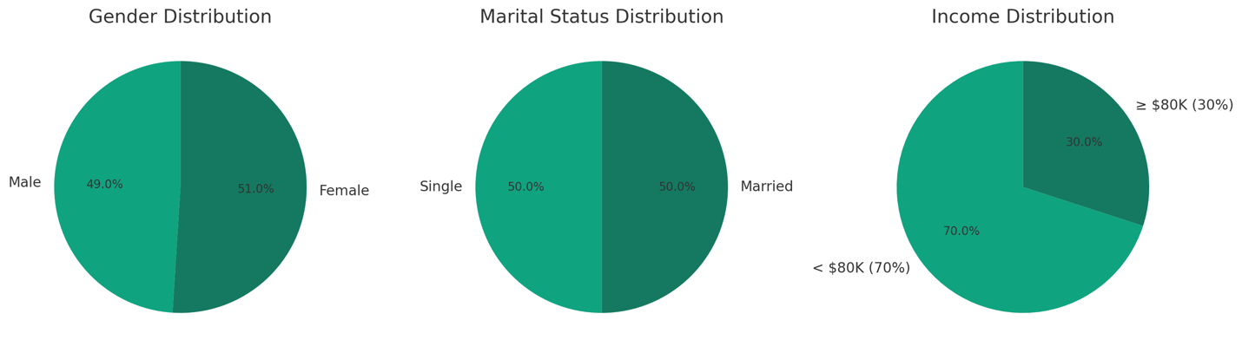
Exploratory Analysis – Key Demographics

Slide 13
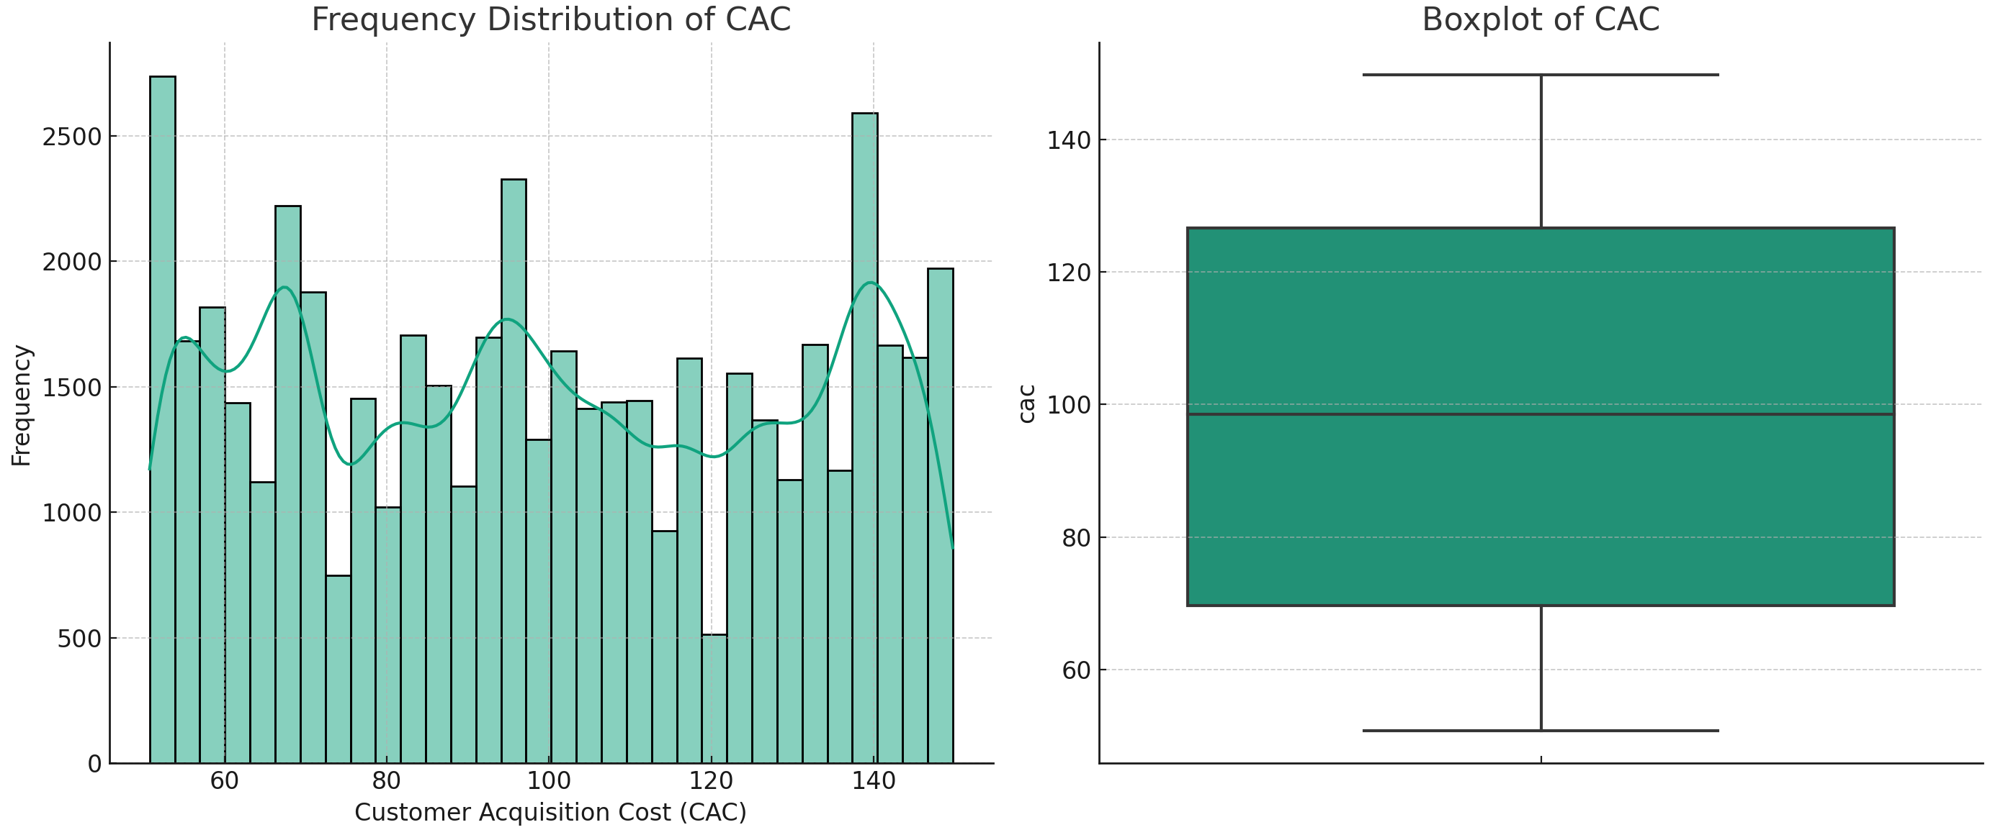
Exploratory Analysis – Target Variable

Slide 14
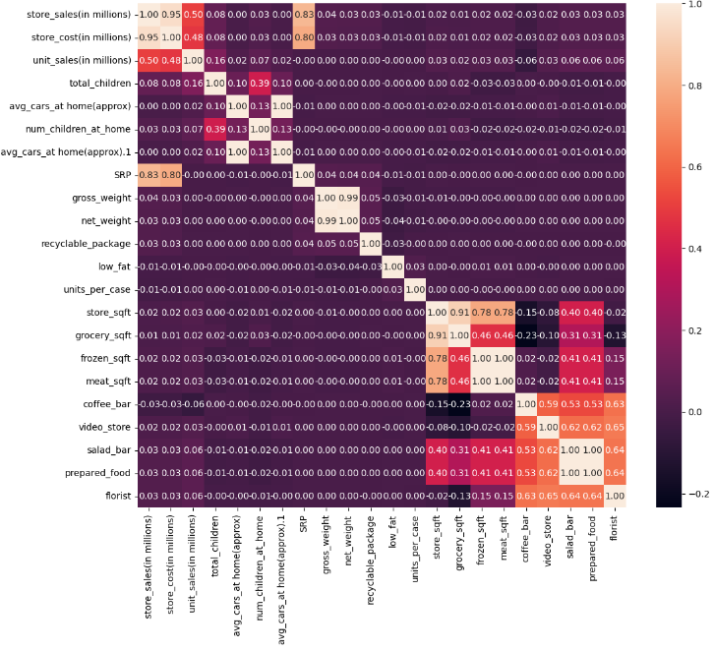
Exploratory Analysis – Correlation Matrix

Slide 15
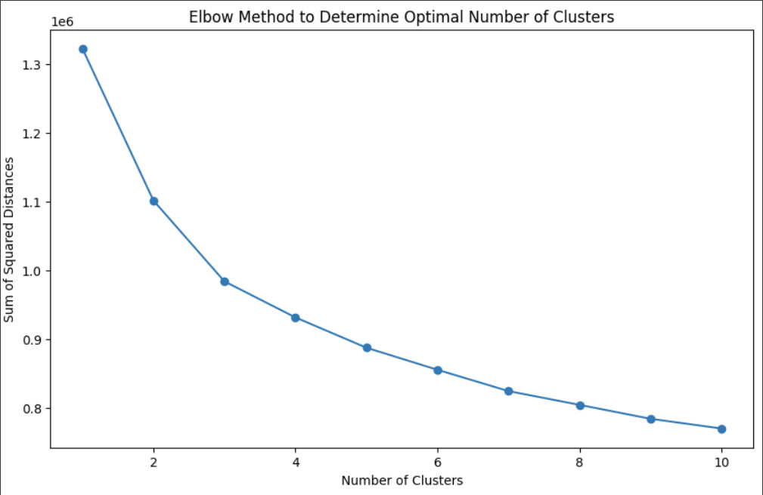
Segmentation Analysis – k-means and elbow method

Slide 16
Segmentation Analysis – Over/Under Index Analysis
Feature | Cluster 1 | Cluster 2 | Cluster 3 | Cluster 4
total_children | 101 | 98 | 100 | 100
num_children_at_home | 105 | 92 | 100 | 103
avg_cars_at_home | 96 | 101 | 101 | 101
marital_status_S | 99 | 104 | 99 | 98
gender_M | 83 | 106 | 105 | 107
avg_yearly_income_40000.0 | 96 | 101 | 102 | 101
avg_yearly_income_60000.0 | 117 | 94 | 94 | 95
avg_yearly_income_80000.0 | 96 | 100 | 106 | 98
avg_yearly_income_100000.0 | 82 | 117 | 103 | 97
avg_yearly_income_120000.0 | 107 | 100 | 102 | 91
education_Graduate Degree | 76 | 104 | 104 | 116
education_High School Degree | 96 | 102 | 104 | 98
education_Partial College | 108 | 96 | 94 | 102
education_Partial High School | 105 | 99 | 98 | 98
occupation_Management | 114 | 95 | 100 | 91
occupation_Manual | 85 | 104 | 102 | 109
occupation_Professional | 93 | 103 | 101 | 104
occupation_Skilled Manual | 110 | 98 | 98 | 93
houseowner_Y | 95 | 101 | 101 | 103
member_card_Golden | 111 | 92 | 97 | 99
member_card_Normal | 99 | 101 | 99 | 101
member_card_Silver | 85 | 108 | 103 | 104
product_food_family_Food | 133 | 133 | 0 | 134
product_food_family_Non-Consumable | 31 | 31 | 308 | 30
sales_country_Mexico | 251 | 41 | 72 | 36
sales_country_USA | 0 | 126 | 117 | 157
store_type_Gourmet Supermarket | 195 | 123 | 83 | 0
store_type_Mid-Size Grocery | 163 | 39 | 88 | 111
store_type_Small Grocery | 0 | 0 | 110 | 290
store_type_Supermarket | 64 | 30 | 102 | 204

Slide 17

Segmentation Analysis – Persona 1

Slide 18

Segmentation Analysis – Persona 2

Slide 19

Segmentation Analysis – Persona 3

Slide 20

Segmentation Analysis – Persona 4

Slide 21
Segmentation Analysis – Evalution
Silhouette score = 0.25

Slide 22
Predictive Modeling - XGBoost
Top 5 Features:
Grocery stores frozen section sqft (0.06)
Grocery stores grocery section sqft (0.04)
Marketing campaign “Price Slashers” (0.03)
Marketing campaign “Big Time Discounts” (0.03)
Advertising strategy – Cash Register Handout (0.03)

Slide 23
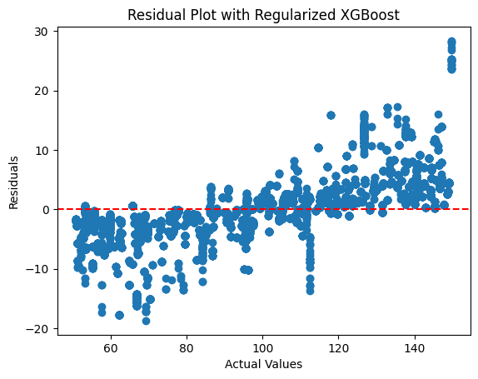
Predictive Modeling - XGBoost

Slide 24
Predictive Modeling – XGBoost Evaluation
MSE: 25.64
MAE: 3.72
R2: 0.97

Slide 25

Proposed Business Solution

Slide 26
Segmentation and Predictive Model Implementation
Implementing segmentation model for building personas
01
Implementing predictive model for estimating customer acquisition cost (CAC)
02

Slide 27
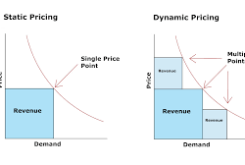
Dynamic Pricing Model

Slide 28
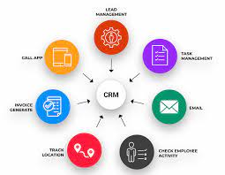
CRM Implementation

Slide 29

References

Slide 30
References
Analytics Vidhya. (2023, March 30). Introduction to XGBoost Algorithm in Machine Learning. Retrieved from Analytics Vidhya: https://www.analyticsvidhya.com/blog/2018/09/an-end-to-end-guide-to-understand-the-math-behind-xgboost/#:~:text=XGBoost%20is%20a%20machine%20learning,won%20several%20machine%20learning%20competitions.
Bhardwaj, A. (2020, May 26). Silhouette Coefficient. Retrieved from Towards Data Science: https://towardsdatascience.com/silhouette-coefficient-validating-clustering-techniques-e976bb81d10c#:~:text=Silhouette%20Coefficient%20or%20silhouette%20score%20is%20a%20metric%20used%20to,each%20other%20and%20clearly%20distinguished.
CSP Daily News. (2017). CONVENIENT FOOD MART. Retrieved from CSP Daily News: https://www.cspdailynews.com/top-202-convenience-stores-2017/convenient-food-mart
Dublino, J. (2023, November 6). What Is Dynamic Pricing, and How Does It Affect E-commerce? Retrieved from Business: https://www.business.com/articles/what-is-dynamic-pricing-and-how-does-it-affect-ecommerce/
Ong, A. (2020, March 16). Segmenting Customers using K-Means, RFM and Transaction Records. Retrieved from Towards Data Science: https://towardsdatascience.com/segmenting-customers-using-k-means-and-transaction-records-76f4055d856a
Raj, A. (2020, June 18). A Quick and Dirty Guide to Random Forest Regression. Retrieved from Towards Data Science: https://towardsdatascience.com/a-quick-and-dirty-guide-to-random-forest-regression-52ca0af157f8#:~:text=ADVANTAGES%20OF%20RANDOM%20FOREST,of%20the%20data%20are%20missing.
Williams, S. (2023, June 14). CRM Customer Retention: 7 Best Ways to Increase Customer Retention With CRM. Retrieved from Big Contacts: https://www.bigcontacts.com/blog/crm-customer-retention/

